Slide 1
Diagnosis of motor neuron disease
Pille Taba, Karin Rallmann
University of Tartu
VI Nordic ALS Alliance Meeting
Aug 21, 2010
Haapsalu, Estonia

Slide 2
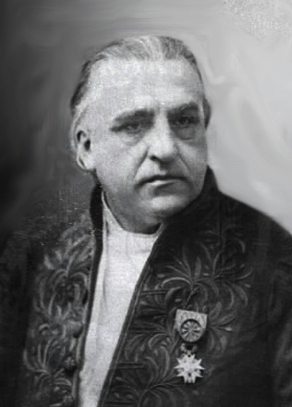
Motor neuron disease (MND)
Charcot J-M. Sclerose des cordons lateraux de la moelle epiniere … Bull Soc Med (Paris) 1865: 24-35.
discussed clinic and pathology of a disorder that affected both upper and lower motor neuron
Charcot disease
Amyotrophic lateral sclerosis (ALS)
Lou Gehrig disease (USA)

Slide 3
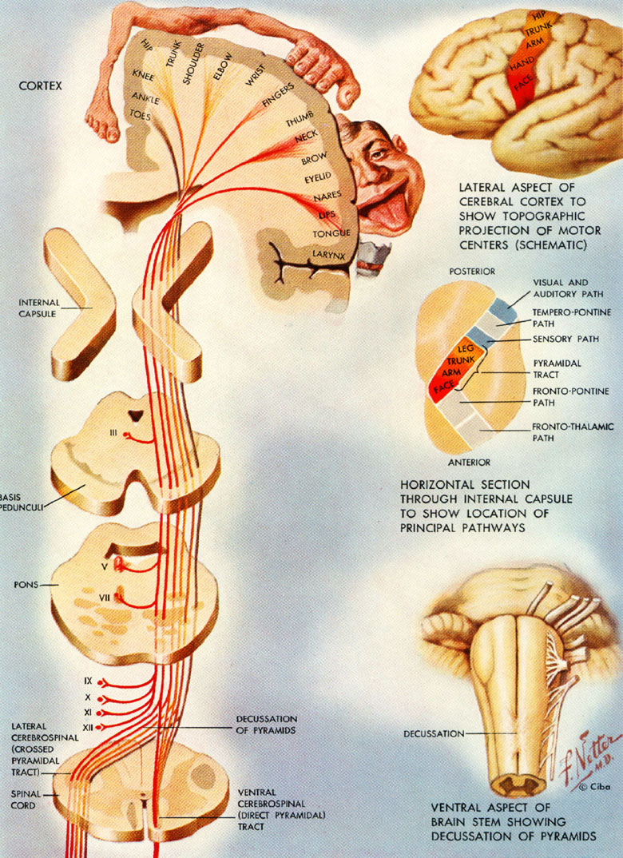
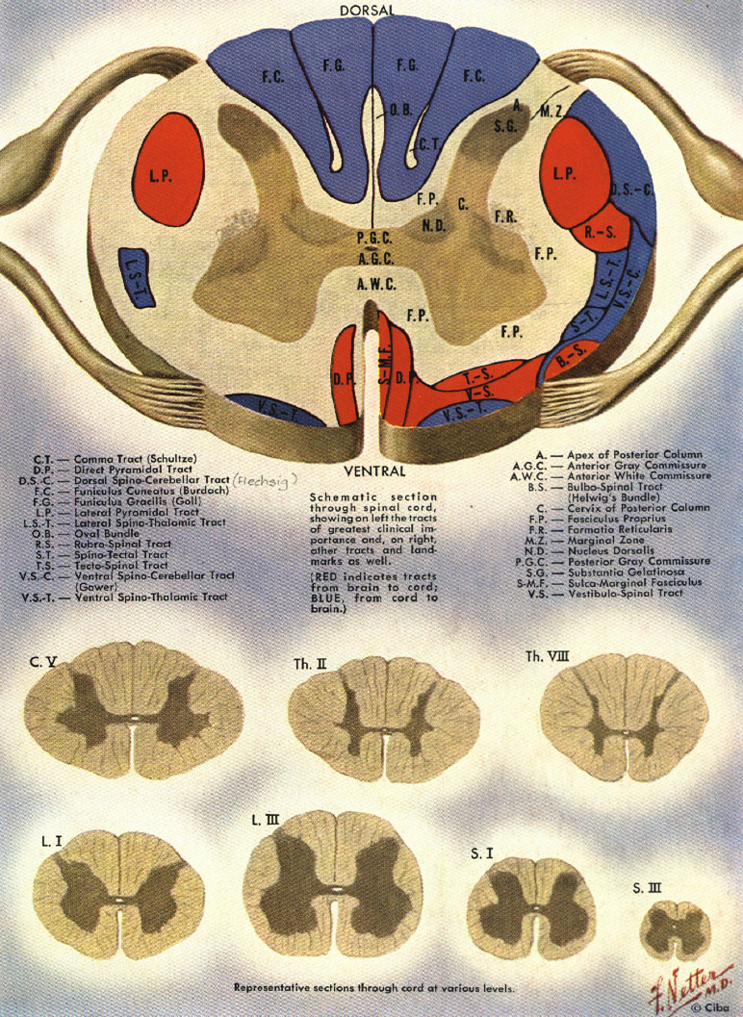
Motor pathway – upper and lower motor neuron

Slide 4
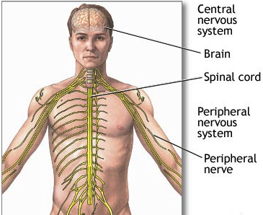
Motor neurons Levels
Bulbar – speech, swallowing
Cervical – upper limbs
Thoracic - trunk
Lumbar – lower limbs

Slide 5
Motor neuron disease Variants
ALS
Amyotrophic lateral sclerosis - upper and lower motor neuron
PMA
Progressive spinal muscular atrophy – pure lower motor neuron
PLS
Primary lateral sclerosis –
pure upper motor neuron
PBP
Progressive bulbar paralysis
Graaff et al 2009

Slide 6
Motor neuron disease Epidemiology
Incidence 1-3 cases per 100 000 per year
In Estonia, incidence 1.3/ 100 000/ year
Prevalence 6-8 per 100 000
Mostly sporadic
Less than 10% familiar
About 20% of familiar ALS cases have SOD1 mutation (Cu/Zn superoxide dismutase enzyme)
Burvill 2009
Gross-Paju et al 1998

Slide 7
Management of chronic disease
Diagnosis
Treatment
Early/ delay
Clinical signs
Testing
Information giving
Disease modifying
Symptomatic
Psychosocial care
Team approach

Slide 8
Diagnostic delay – why?
Motor neuron disease – rare
Variability of clinical picture
Lack of diagnostic markers
Delay of recognition of the disease by patient/ family or primary physician
Time from the first symptoms to the confirmation of diagnosis – 14 months
Murray et al 2004
Swash 1999

Slide 9
Theoretical timeline
Preclinical
detectable
genetically (?)
Identifiable
by imaging,
molecular
markers (?)
Clinically
overt
disease
Motor
function
TIME
Eisen 2009

Slide 10
Basis of diagnosis – history and clinical signs
Dysarthria, dysphagia, paucity of tongue movements
Muscle weakness and wasting
Hand dysfunction
Foot drop
Fasciculations/ cramps
Spastic gait
Respiratory failure
Progressive course

Slide 11
Diagnostic criteria
World Federation of Neurology, Subcommittee on MND/ ALS - El Escorial Revisited Criteria (1998)
Clinically definite ALS: upper and lower motor neuron signs in three regions
Clinically probable ALS: upper and lower motor neuron signs in two regions
Clinically probably laboratory supported ALS: upper and lower motor neuron dysfunction in one region + EMG
Clinically possible ALS: dysfunction in one region
Suspected ALS: only lower motor neuron signs
Subcommittee on MND/ALS
of WFN 1994; 1998

Slide 12
Symptoms to concern/ mimic syndromes
Absence of fasciculations
Sensory impairment
Autonomic dysfunction
Eye movement abnormalities
Sphincter impairment
Movement disorders
Cognitive impairment (Alzheimer type)
Symmetrical lower motor neuron signs
Mitchell 2007

Slide 13
Incorrect diagnosis (initial diagnosis)
Cervical myelopathy
Multifocal motor neuropathy
Multiple sclerosis (primary progressive)
Radiculpathy (painless)
Chronic inflammatory demyelinating polyneuropathy
Myositis
Cerebrovascular disease
Periarthritis
Eisen 2009
Gross-Paju et al 1998

Slide 14
Differential diagnosis of ALS
Muscle diseases
Diseases of neuromuscular junction
Diseases of anterior horn cells
Diseases of spinal cord
Diseases of central nervous system
Systemic disorders

Slide 15
Differential diagnosis
To exclude other causes of a slowly progressive spastic paraparesis
Cervical disc
Hereditary spastic paraplegia
…
Investigation
Imaging: MRI – cervical, bulbar
EMG

Slide 16
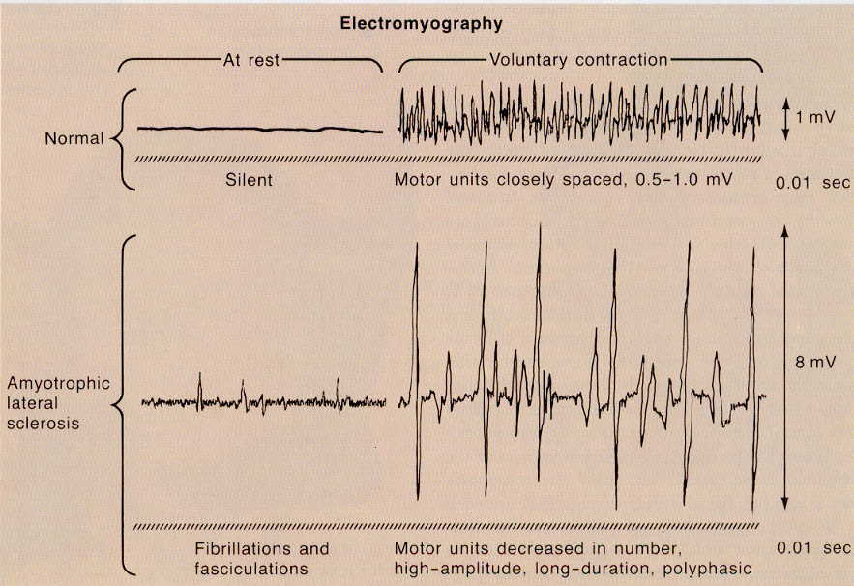
Confirming the diagnosis of MND/ ALS Investigations: electroneuromyography

Slide 17
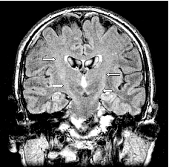
Investigations: imaging
MRI – magnetic resonance imaging
DTI – diffusion tensor imaging of the cortical spinal tract
MR spectroscopy
N-acetyl aspartate (NAA), marker for upper motor neuron degeneration
myo-inositol (MI), marker for glial activity
MRI T2-weighted (FLAIR)
Graaff et al 2009

Slide 18
Investigations: laboratory sampling
No specific biomarkers for confirming ALS
For excluding different pathology
Metabolic studies: blood chemistry
Endocrinologic studies: thyroid function etc
Screening monoclonal gammopathy: viruses
CSF: exclude inflammatory processes

Slide 19
Functional scales – measuring change in status
ALSFRS – ALS Functional Rating Scale
To assess the more important activities
Complete reliability and validity testing
Norris Scale
Appel Scale
Additionally history
Uses manual muscle testing (MMT)
Tufts Quantitative Neuromuscular Exam
Maximal voluntary isometric contraction
Repetitive functional test
Munsat 1996

Slide 20
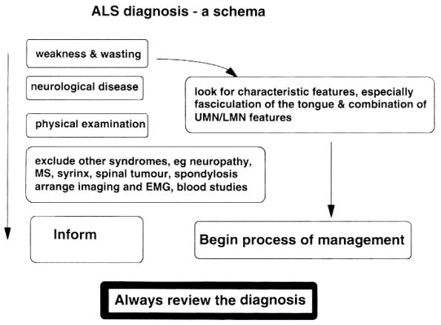
Swash 1999

Slide 21
Neurologist
Family doctor
Neurophysiologist
Rehabilitation
doctor
Family
Carer
Nurse
Patient
Physiotherapist
Dietician
Occupational
therapist
Radiologist
Speech
therapist
Psychologist
Social worker

